Slide 1
Linear Regression

Slide 2
What is Regression?
What is regression? Given n data points
best fit
to the data. The best fit is generally based on
minimizing the sum of the square of the residuals,
.
Residual at a point is
Sum of the square of the residuals
Figure. Basic model for regression

Slide 3
Linear Regression-Criterion
Given n data points
best fit
to the data.
y
x
Figure. Linear regression of y vs. x data showing residuals at a typical point, x_{i} .
Does minimizing
work as a criterion, where

Slide 4
Least Squares Criterion
The least squares criterion minimizes the sum of the square of the residuals in the model, and also produces a unique line.
y
x
Figure. Linear regression of y vs. x data showing residuals at a typical point, x_{i} .

Slide 5
Finding Constants of Linear Model
Minimize the sum of the square of the residuals:
To find
and
we minimize
with respect to
and
.
giving

Slide 6
Finding Constants of Linear Model
Solving for
and
directly yields,
and

Slide 7
Example 1
The torque, T needed to turn the torsion spring of a mousetrap through an angle, is given below.
Find the constants for the model given by
Table: Torque vs Angle for a torsional spring
Angle, θ | Torque, T
Radians | N-m
0.698132 | 0.188224
0.959931 | 0.209138
1.134464 | 0.230052
1.570796 | 0.250965
1.919862 | 0.313707
Figure. Data points for Angle vs. Torque data

Slide 8
Example 1 cont.
The following table shows the summations needed for the calculations of the constants in the regression model.
Table. Tabulation of data for calculation of important
summations
Radians | N-m | Radians² | N-m-Radians
0.698132 | 0.188224 | 0.487388 | 0.131405
0.959931 | 0.209138 | 0.921468 | 0.200758
1.134464 | 0.230052 | 1.2870 | 0.260986
1.570796 | 0.250965 | 2.4674 | 0.394215
1.919862 | 0.313707 | 3.6859 | 0.602274
6.2831 | 1.1921 | 8.8491 | 1.5896
Using equations described for
and
with
N-m/rad

Slide 9
Example 1 cont.
Use the average torque and average angle to calculate
Using,
N-m

Slide 10
Example 1 Results
Using linear regression, a trend line is found from the data
Figure. Linear regression of Torque versus Angle data
Can you find the energy in the spring if it is twisted from 0 to 180 degrees?

Slide 11
Example 2
To find the longitudinal modulus of composite, the following data is collected. Find the longitudinal modulus,
using the regression model
Table. Stress vs. Strain data
and the sum of the square of the
Strain | Stress
(%) | (MPa)
0 | 0
0.183 | 306
0.36 | 612
0.5324 | 917
0.702 | 1223
0.867 | 1529
1.0244 | 1835
1.1774 | 2140
1.329 | 2446
1.479 | 2752
1.5 | 2767
1.56 | 2896
residuals.
Figure. Data points for Stress vs. Strain data

Slide 12
Example 2 cont.
Residual at each point is given by
The sum of the square of the residuals then is
Differentiate with respect to
Therefore

Slide 13
Example 2 cont.
Table. Summation data for regression model
With
i | ε | σ | ε ² | εσ
1 | 0.0000 | 0.0000 | 0.0000 | 0.0000
2 | 1.8300x10⁻³ | 3.0600x10⁸ | 3.3489x10⁻⁶ | 5.5998x10⁵
3 | 3.6000x10⁻³ | 6.1200x10⁸ | 1.2960x10⁻⁵ | 2.2032x10⁶
4 | 5.3240x10⁻³ | 9.1700x10⁸ | 2.8345x10⁻⁵ | 4.8821x10⁶
5 | 7.0200x10⁻³ | 1.2230x10⁹ | 4.9280x10⁻⁵ | 8.5855x10⁶
6 | 8.6700x10⁻³ | 1.5290x10⁹ | 7.5169x10⁻⁵ | 1.3256x10⁷
7 | 1.0244x10⁻² | 1.8350x10⁹ | 1.0494x10⁻⁴ | 1.8798x10⁷
8 | 1.1774x10⁻² | 2.1400x10⁹ | 1.3863x10⁻⁴ | 2.5196x10⁷
9 | 1.3290x10⁻² | 2.4460x10⁹ | 1.7662x10⁻⁴ | 3.2507x10⁷
10 | 1.4790x10⁻² | 2.7520x10⁹ | 2.1874x10⁻⁴ | 4.0702x10⁷
11 | 1.5000x10⁻² | 2.7670x10⁹ | 2.2500x10⁻⁴ | 4.1505x10⁷
12 | 1.5600x10⁻² | 2.8960x10⁹ | 2.4336x10⁻⁴ | 4.5178x10⁷
 |  |  | 1.2764x10⁻³ | 2.3337x10⁸
and
Using

Slide 14
Example 2 Results
The equation
describes the data.
Figure. Linear regression for Stress vs. Strain data

Slide 15
Nonlinear Regression

Slide 16
Nonlinear Regression
Some popular nonlinear regression models:
1. Exponential model:
2. Power model:
3. Saturation growth model:
4. Polynomial model:

Slide 17
Nonlinear Regression
Given n data points
best fit
to the data, where
is a nonlinear function of
.
Figure. Nonlinear regression model for discrete y vs. x data

Slide 18
Regression Exponential Model: Example

Slide 19
Exponential Model
Given
best fit
to the data.
Figure. Exponential model of nonlinear regression for y vs. x data

Slide 20
Finding constants of Exponential Model
The sum of the square of the residuals is defined as
Differentiate with respect to a and b

Slide 21
Finding constants of Exponential Model
Rewriting the equations, we obtain

Slide 22
Finding constants of Exponential Model
Solving the first equation for
yields
Substituting
back into the previous equation
Nonlinear equation in terms of
The constant
can be found through numerical methods such
as the bisection method or secant method.

Slide 23
Exponential Model
Relative intensity of radiation of technetium 99m as a function of time
t(hrs) | 0 | 1 | 3 | 5 | 7 | 9
 | 1.000 | 0.892 | 0.708 | 0.562 | 0.447 | 0.355
Best fit the data to an exponential model and find the
relative intensity of radiation of technetium 99m after 24 hours

Slide 24
Example 1-Exponential Model
Many patients get concerned when a test involves injection of a radioactive material. For example for scanning a gallbladder, a few drops of Technetium-99m isotope is used. Half of the techritium-99m would be gone in about 6 hours. It, however, takes about 24 hours for the radiation levels to reach what we are exposed to in day-to-day activities. Below is given the relative intensity of radiation as a function of time.
Table. Relative intensity of radiation as a function
of time
t(hrs) | 0 | 1 | 3 | 5 | 7 | 9
 | 1.000 | 0.892 | 0.708 | 0.562 | 0.447 | 0.355
Figure. Data points of relative radiation intensity vs. time

Slide 25
Example 1-Exponential Model cont.
Find:
a) The value of the regression constants
and
b) The half-life of Technium-99m
c) Radiation intensity after 24 hours
The relative intensity is related to time by the equation

Slide 26
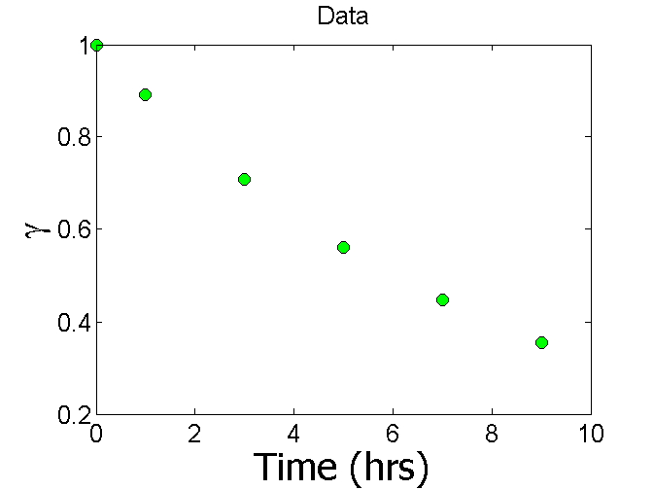
Plot of data

Slide 27
Constants of the Model
The value of λ is found by solving the nonlinear equation

Slide 28
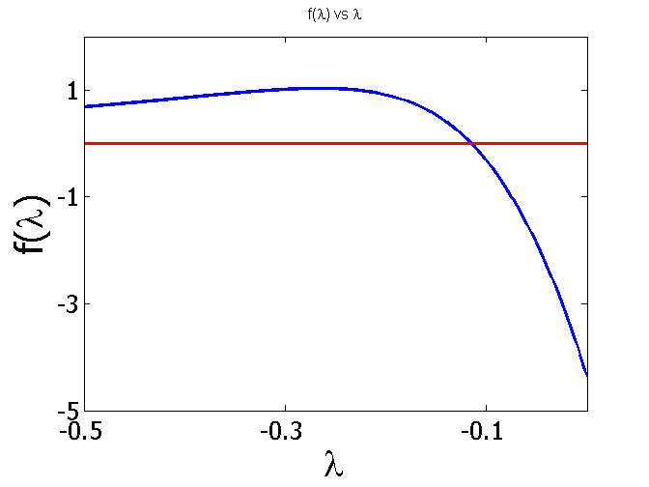
t (hrs) | 0 | 1 | 3 | 5 | 7 | 9
γ | 1.000 | 0.892 | 0.708 | 0.562 | 0.447 | 0.355

Slide 29
By solving the nonlinear equation
The value of A can now be calculated
The exponential regression model then is

Slide 30
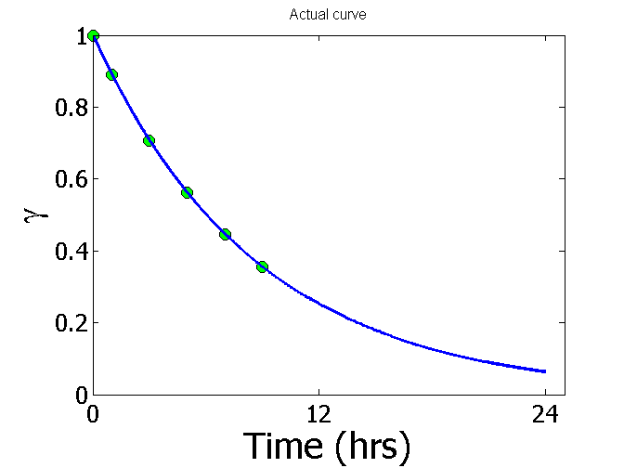
Plot of data and regression curve

Slide 31
Relative Intensity After 24 hrs
The relative intensity of radiation after 24 hours
This result implies that only
radioactive intensity is left after 24 hours.

Slide 32
Homework
What is the half-life of technetium 99m isotope?
Compare the constants of this regression model with the one where the data is transformed.
Write a program in the language of your choice to find the constants of the model.

Slide 33
Polynomial Model
Given
best fit
to a given data set.
Figure. Polynomial model for nonlinear regression of y vs. x data

Slide 34
Polynomial Model
The residual at each data point is given by
The sum of the square of the residuals then is

Slide 35
Polynomial Model
To find the constants of the polynomial model, we set the derivatives with respect to
where
equal to zero.

Slide 36
Polynomial Model
These equations in matrix form are given by
The above equations are then solved for

Slide 37
Example 2-Polynomial Model
Regress the thermal expansion coefficient vs. temperature data to a second order polynomial.
Table. Data points for temperature vs
Temperature, T (ºF) | Coefficient of thermal expansion, α (in/in/ºF)
80 | 6.47x10⁻⁶
40 | 6.24x10⁻⁶
-40 | 5.72x10⁻⁶
-120 | 5.09x10⁻⁶
-200 | 4.30x10⁻⁶
-280 | 3.33x10⁻⁶
-340 | 2.45x10⁻⁶
Figure. Data points for thermal expansion coefficient vs temperature.

Slide 38
Example 2-Polynomial Model
We are to fit the data to the polynomial regression model
The coefficients
are found by differentiating the sum of the
square of the residuals with respect to each variable and setting the
values equal to zero to obtain

Slide 39
Example 2-Polynomial Model
The necessary summations are as follows
Table. Data points for temperature vs.
Temperature, T (ºF) | Coefficient of thermal expansion, α (in/in/ºF)
80 | 6.47x10⁻⁶
40 | 6.24x10⁻⁶
-40 | 5.72x10⁻⁶
-120 | 5.09x10⁻⁶
-200 | 4.30x10⁻⁶
-280 | 3.33x10⁻⁶
-340 | 2.45x10⁻⁶

Slide 40
Example 2-Polynomial Model
Using these summations, we can now calculate
Solving the above system of simultaneous linear equations we have
The polynomial regression model is then

Slide 41
Linearization of Data
To find the constants of many nonlinear models, it results in solving simultaneous nonlinear equations. For mathematical convenience, some of the data for such models can be linearized. For example, the data for an exponential model can be linearized.
As shown in the previous example, many chemical and physical processes are governed by the equation,
Taking the natural log of both sides yields,
Let
and
We now have a linear regression model where
(implying)
with

Slide 42
Linearization of data cont.
Using linear model regression methods,
Once
are found, the original constants of the model are found as

Slide 43
Example 3-Linearization of data
Many patients get concerned when a test involves injection of a radioactive material. For example for scanning a gallbladder, a few drops of Technetium-99m isotope is used. Half of the techritium-99m would be gone in about 6 hours. It, however, takes about 24 hours for the radiation levels to reach what we are exposed to in day-to-day activities. Below is given the relative intensity of radiation as a function of time.
Table. Relative intensity of radiation as a function
of time
t(hrs) | 0 | 1 | 3 | 5 | 7 | 9
 | 1.000 | 0.892 | 0.708 | 0.562 | 0.447 | 0.355
Figure. Data points of relative radiation intensity vs. time

Slide 44
Example 3-Linearization of data
Find:
a) The value of the regression constants
and
b) The half-life of Technium-99m
c) Radiation intensity after 24 hours
The relative intensity is related to time by the equation

Slide 45
Example 3-Linearization of data cont.
Exponential model given as,
Assuming
,
and
we obtain
This is a linear relationship between
and

Slide 46
Example 3-Linearization of data
Using this linear relationship, we can calculate
where
and

Slide 47
Example 3-Linearization of Data
Summations for data linearization are as follows
With
Table. Summation data for linearization of data model
1 2 3 4 5 6 | 0 1 3 5 7 9 | 1 0.891 0.708 0.562 0.447 0.355 | 0.00000 -0.11541 -0.34531 -0.57625 -0.80520 -1.0356 | 0.0000 -0.11541 -1.0359 -2.8813 -5.6364 -9.3207 | 0.0000 1.0000 9.0000 25.000 49.000 81.000
 | 25.000 |  | -2.8778 | -18.990 | 165.00

Slide 48
Example 3-Linearization of Data
Calculating
Since
also

Slide 49
Example 3-Linearization of Data
Resulting model is
Figure. Relative intensity of radiation as a function of temperature using linearization of data model.

Slide 50
Example 3-Linearization of Data
The regression formula is then
b) Half life of Technetium 99 is when

Slide 51
Example 3-Linearization of Data
c) The relative intensity of radiation after 24 hours is then
This implies that only
of the radioactive
material is left after 24 hours.

Slide 52
Comparison
Comparison of exponential model with and without data linearization:
Table. Comparison for exponential model with and without data linearization.
 | With data linearization (Example 3) | Without data linearization (Example 1)
A | 0.99974 | 0.99983
λ | -0.11505 | -0.11508
Half-Life (hrs) | 6.0247 | 6.0232
Relative intensity after 2 hrs. | 6.3160x10⁻² | 6.3200x10⁻²
The values are very similar so data linearization was suitable to find the constants of the nonlinear exponential model in his case.

Slide 53
Multiple Regression
다중회귀분석(multiple regression analysis)은 단순회귀분석의 확장으로 독립변수가 두개 이상인 회귀모형에 대한 분석
다중 회귀 모형의 변형 예(비선형 모델)

